Slide 1


André Calado
12 September 2022

Slide 2

Outline
Executive Summary
Introduction
Methodology
Results
Conclusion
Appendix

Slide 3
Executive Summary
The main goal of this analysis was to find if the reusability of the SpaceX’s Falcon 9 rockets first stage could be predicted using historical data from previous launches.
Firstly, data was collected via SpaceX API and Wikipedia, then it was processed. Next, EDA was performed to get some insights and some visualizations were created. Lastly, predictive analysis was done using classification models.
The results showed that the prediction can be made with a fair level of confidence.

Slide 4
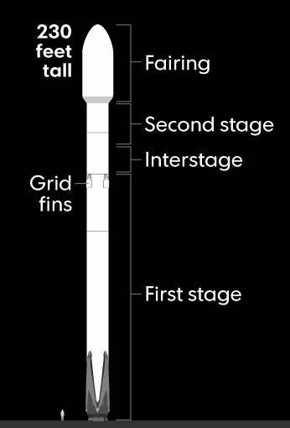
Introduction
SpaceX is one of the most prolific commercial space agencies nowadays. One of the main advantages that the company holds against its competitors is the reduced cost of their Falcon 9 rocket launches of 62 million dollars, while other providers cost up to 165 million dollars.
These savings are much due to the fact that Falcon 9 rockets can reuse their first stage. Yet sometimes the first stage does not land, either by choice or because it crashes.
The main question to answer with this analysis is if the successful landing of a first stage can be predicted given different parameters of the launch.

Slide 5

Section 1

Slide 6
Methodology
Executive Summary
Data collection methodology:
SpaceX API & Web scrapping
Perform data wrangling
Replace missing values with mean
Creation of dummy variables
Perform exploratory data analysis (EDA) using visualization and SQL
Perform interactive visual analytics using Folium and Plotly Dash
Perform predictive analysis using classification models
Standardize, split train and test data, use GridSearchCV to find best parameters for each model from: Logistic Regresion, Support Vector Machine, Decision Tree Classifier and K Nearest Neighbors

Slide 7
Data Collection
Data was collected via two ways:
SpaceX API – Publicly displayed information and data offered by the company itself
https://api.spacexdata.com/v4/launches/past
Wikipedia – Scraping of the Wikipedia page regarding Space X launches
https://en.wikipedia.org/wiki/List_of_Falcon_9_and_Falcon_Heavy_launches

Slide 8
Data Collection – SpaceX API
Request via requests.get()
Decode response as JSON to DataFrame with pd.json_normalize()
Saving to new DataFrame only Falcon 9 records and only the parameters that we want to analyse
Missing values were replaced with the mean (Except for “LandingPad” to represent where landing pads were not used).
https://github.com/ASPCalado/Capstone_project/blob/main/Data_Collection_API.ipynb
Request data from API
JSON -> DataFrame
Filtering Data
Dealing with Missing Values

Slide 9
Data Collection - Scraping
Request data from url
Create BeautifulSoup object
HTML table -> DataFrame
Request via requests.get()
Create BeautifulSoup object based on the response’s HTML.
Parse the desired table to a new DataFrame
https://github.com/ASPCalado/Capstone_project/blob/main/Data_Collection_Web_Scrapping.ipynb

Slide 10
Data Wrangling
Some very basic EDA was performed to understand what needed to be done
The column “Outcome” had different values (for example “True Ocean”, “False ASDS”), so a new column was created where 0 represented an unsuccessful landing and 1 a successful one.
https://github.com/ASPCalado/Capstone_project/blob/main/Data_Wrangling.ipynb

Slide 11
EDA with Data Visualization
The main goal of the EDA was to find out which parameters would show some relationship with the outcome of the first stage landing, so the parameters used were those that intuitively seemed like they would.
Therefore, the visualizations that were used were a combination of the following variables:
https://github.com/ASPCalado/Capstone_project/blob/main/EDA_Data_Viz.ipynb
Flight Number – represents continuous launch attempts;
Payload Mass
Launch Site
Orbit – type of orbit
Year
Outcome

Slide 12
EDA with SQL
The EDA with SQL was used to find out:
Unique launch sites
Total payload mass carried by boosters launched by NASA
Average payload mass carried by booster version F9 v1.1
The date when the first succesful landing outcome in ground pad was achieved
Boosters which have success in drone ship and have payload mass greater than 4000 but less than 6000
Booster versions which have carried the maximum payload mass.
List the records which will display the month names, failure landing_outcomes in drone ship ,booster versions, launch_site for the months in year 2015.
Rank the count of successful landing outcomes between the date 04-06-2010 and 20-03-2017
https://github.com/ASPCalado/Capstone_project/blob/main/EDA_SQL.ipynb

Slide 13
Build an Interactive Map with Folium
The created map on Folium had the following objects:
Marker and Circle with the coordinates of the different launch sites.
Marker for each launch with different colors (red = failed, green = success)
MousePosition to get coordinates when hovering over the map
One line and icon to display the distance between one launch site and the nearest sea coast
One line and icon to display the distance between one launch site and the nearest city
https://github.com/ASPCalado/Capstone_project/blob/main/Data_Viz_Folium.ipynb

Slide 14
Build a Dashboard with Plotly Dash
There are two interactive graphs: a pie chart and a scatterplot. Also, there are two inputs for the user: a dropdown menu to choose which launch site they want to analyze and a range slider to select a payload range (in Kg)
The pie chart can display two different things:
If the user selects ‘All Sites’, it shows the % of Total Successful Launches by Site
If the user selects a site, it show the % of Successful vs Unsuccessful Launches in that site
The scatterplot displays the Correlation between Payload and Success for either one or all sites, for the specified range of payload
https://github.com/ASPCalado/Capstone_project/blob/main/Data_Viz_Dash.ipynb

Slide 15
Build a Dashboard with Plotly Dash
The interactivity allows the user to analyze different things.
On the pie chart:
By choosing “All Sites”, the user can see which sites have the highest gross total of successful launches
By choosing a specific site, the user can infer what is the success rate for each site, instead of its gross total value.
On the scatterplot:
The user can have an impression if the payload influences success for all sites generally, or for a specific site
If the user wants to thoroughly analyze a specific payload range, it is possible due to the range slider.

Slide 16
Predictive Analysis (Classification)
Assign variables
Standardize Data
Split train and test data
Use GridSearchCV for diferent algorithms
Calculate score for each algorithm
Assign Y to “Class” column (i.e. outcome) and X to the other variables
Standardize data using StandardScaler()
Split into test and training data with test size of 20%
Use GridSearchCV to find the best parameters for Logistic Regression, Support Vector Machine, Decision Tree classifier and K-Nearest Neighbors algorithms.
For each of them, calculate the accuracy (.score())
https://github.com/ASPCalado/Capstone_project/blob/main/Predictive_Analysis_(Classification).ipynb

Slide 17
Results
Exploratory data analysis results
Interactive analytics demo in screenshots
Predictive analysis results

Slide 18

Section 2

Slide 19
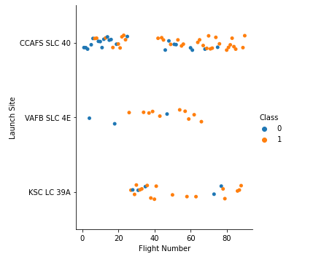
Flight Number vs. Launch Site
The most recent launches (Flight Number represents consecutive launches) tend to be more successful (Class = 1) than the initial launches.
The launch site where this becomes more obvious is VAFB SLC 4E, but it is still valid for the other sites.
We can also observe that KSC LC 39A started to be used later than its peers, and VAFB SLC 4E hasn’t been used recently.

Slide 20
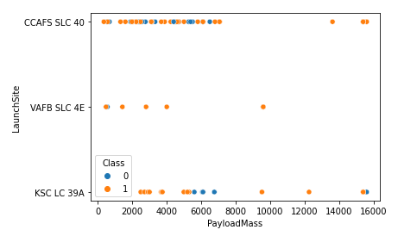
Payload vs. Launch Site
There have been no launches with heavy payload on VAFB SLC 4E
For the values above 7000 Kg, the number of successful launches greatly outweights the unsuccessful.
For KSC LC 39 A all launches with less than 5000 Kg payload have been successful

Slide 21
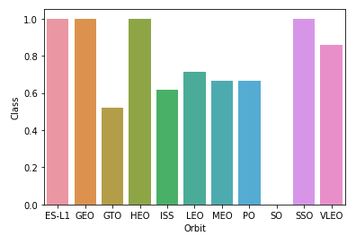
Success Rate vs. Orbit Type
The “Class” axis represents the mean of the class value for launches with that orbit type, so we can use those values as if they were a percentagem
There are three orbit types with a success rate of 100% and one with 0%.
The rest have mostly values between 50% and 70%.

Slide 22
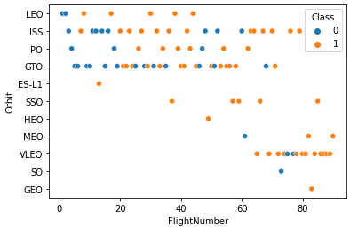
Flight Number vs. Orbit Type
The plot shows na interesting feature: if we look at orbit types individually, the successful (and unsuccessful) seem to group themselves over time, i. e., they tend to appear in a consecutive matter
It also shows that the results for the orbit types that had extreme percentages on the previous bar chart were biased by the fact that most of them had just 1 launch.
Additionally, the orbit types with the highest success rate have been used more recently

Slide 23
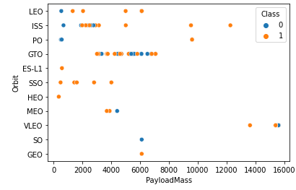
Payload vs. Orbit Type
For some orbit types the success rate is higher for heavy payloads, for example LEO, ISS and PO
For GTO, although the Payload Mass range isn’t very big, the successfull landings are very disperse.

Slide 24
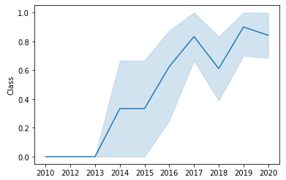
Launch Success Yearly Trend
There were no successful launches until 2013
The success rate has been increasing until then, as the conclusion drawn from the Flight Number analysis
For the most recente years, the rate as been around 0.8

Slide 25
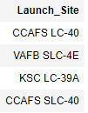
All Launch Site Names
There are 4 launch sites
On the visualizations that will be later presented, we can see that both CCAFS sites are on the same location

Slide 26
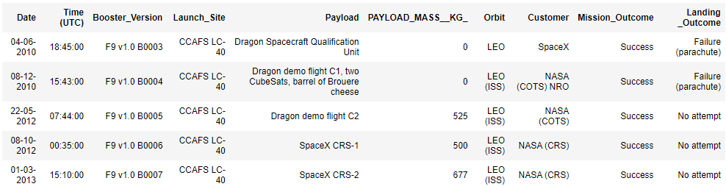
Launch Site Names Begin with 'CCA'
Here there are five examples of launches in locations beginning with “CCA”

Slide 27
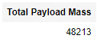
Total Payload Mass
The total payload mass for boosters launched by NASA (CRS)

Slide 28
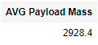
Average Payload Mass by F9 v1.1
Calculate the average payload mass carried by booster version F9 v1.1

Slide 29
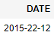
First Successful Ground Landing Date
The date of the first successful landing outcome on ground pad:

Slide 30
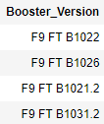
Successful Drone Ship Landing with Payload between 4000 and 6000
List of the boosters which have successfully landed on drone ship and had payload mass greater than 4000 but less than 6000

Slide 31
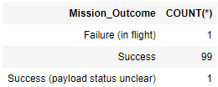
Total Number of Successful and Failure Mission Outcomes
Total number of successful and failure mission outcomes
There has only been one failed mission (Mission Outcome here is the success of the flight, not of its first stage landing, hence the disparity to the previous numbers regarding success)

Slide 32
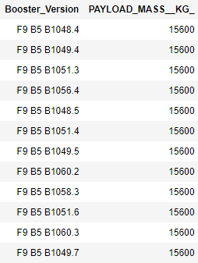
Boosters Carried Maximum Payload
List of the names of the booster which have carried the maximum payload mass
It can be also seen that the maximum payload weights 15600 Kg

Slide 33
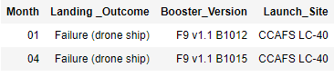
2015 Launch Records
List of the failed landing outcomes in drone ship, their booster versions, and launch site names in year 2015
We can see that there were only two landing fails, both with booster version F9 v1.1 and in CCAFS LC-40

Slide 34
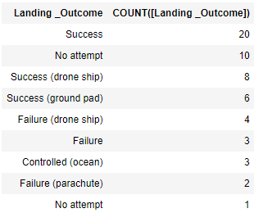
Rank Landing Outcomes Between 2010-06-04 and 2017-03-20
In this period of time, there were more successful landings than failures.
There was also a significant number of flights where first stage landing wasn’t attempted

Slide 35

Section 3

Slide 36
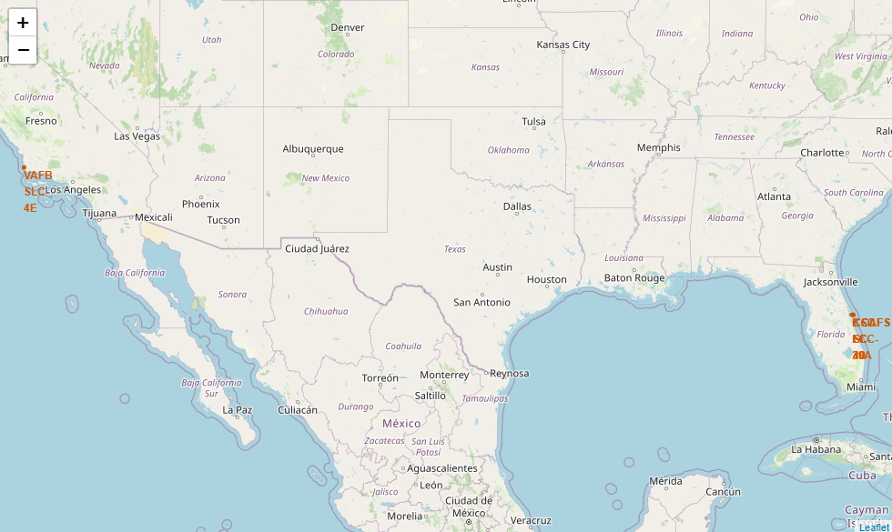
Launch Sites Map
The map marks the launch sites of SpaceX Falcon 9
We can see that these sites are divided between the US West and East coast, both close to the see
KSC LC-39A, CCAFS LC-40 and CCAFS SLC-40 are very close to each other and overlap with low zoom levels

Slide 37
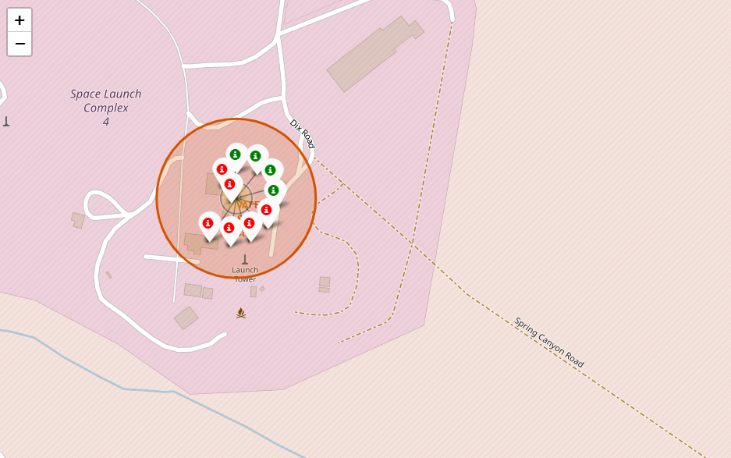
Launch Success Map
Here we can see the amount of successful (green label) and unsuccessful launches for one of the launch sites
This makes it visually intuitive to understand what is the success rate for each site

Slide 38
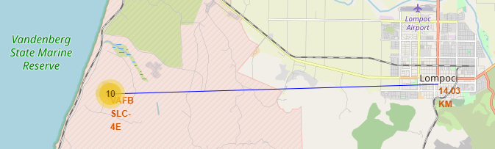
Launch Site distance to closest City
We can see that the closest city to VAFB SLC-4E is Lompoc with a distance of 14.03 Km.
It is also notable that there aren’t inhabitable buildings around the launch site, probably for security reasons

Slide 39

Section 4

Slide 40
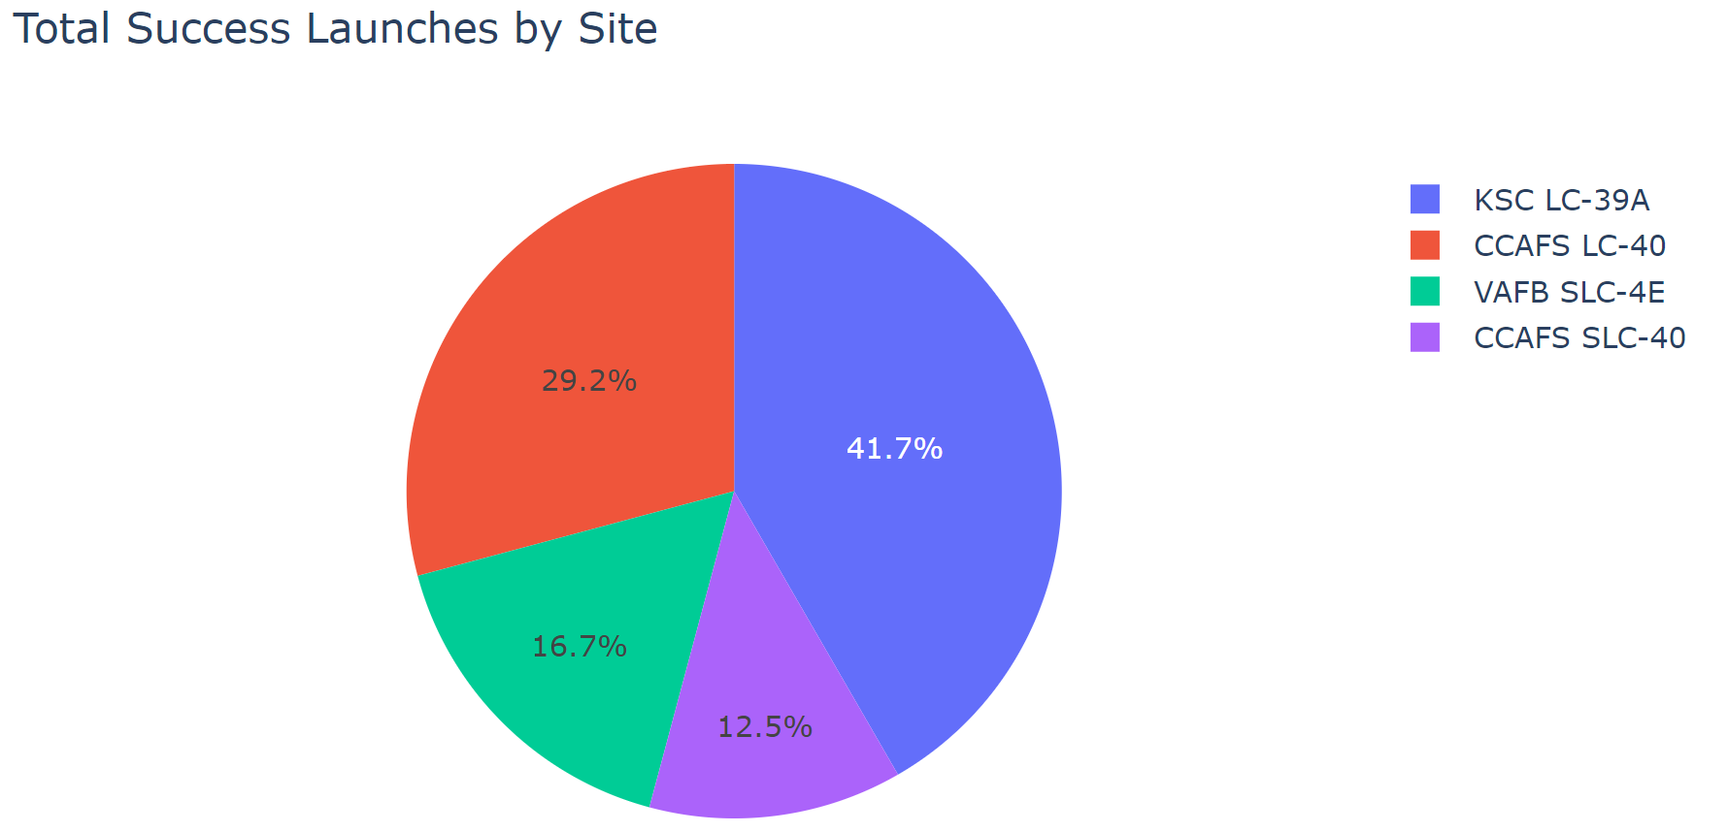
Total Launches by Site
Close to half of the successful launches were on KSC LC-39A
It is followed by CCADS LC-40 which has a significant share of the successful lauches
By pairing the chart with the previous maps, we see that the majority of successful launches were on the East coast

Slide 41
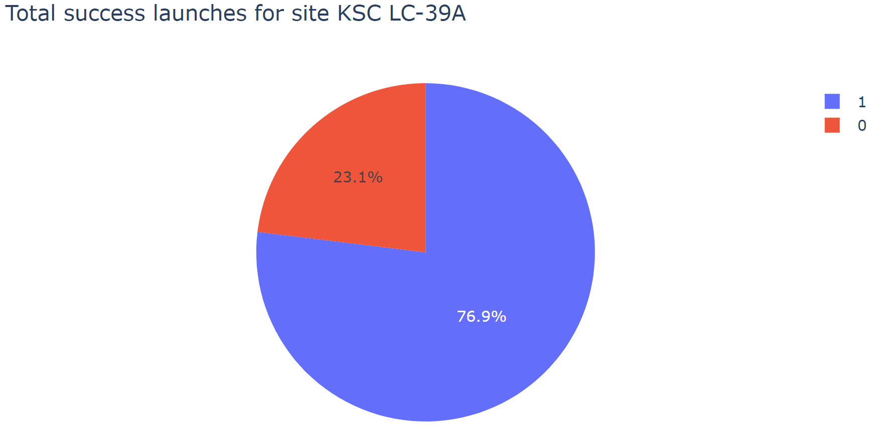
Highest Launch Success Ratio Site
KSC LC-39A is also the site with the highest ratio
Around three out of four launches in this site were successful

Slide 42
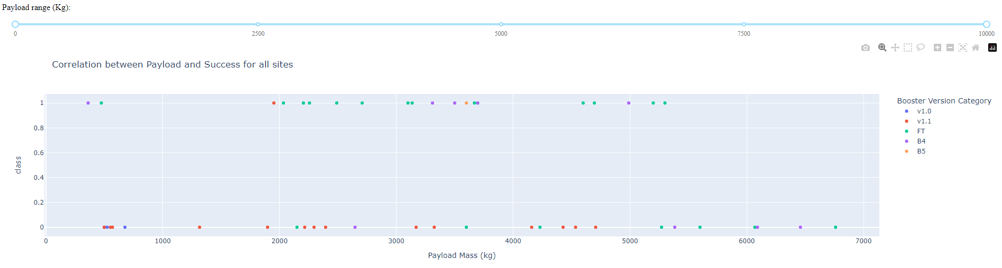
Payload vs. Launch Outcome
Successful launches seem to be more concentrated in the range between 2000 Kg and 4000 Kg, with also some launches with around 5000 Kg payload

Slide 43
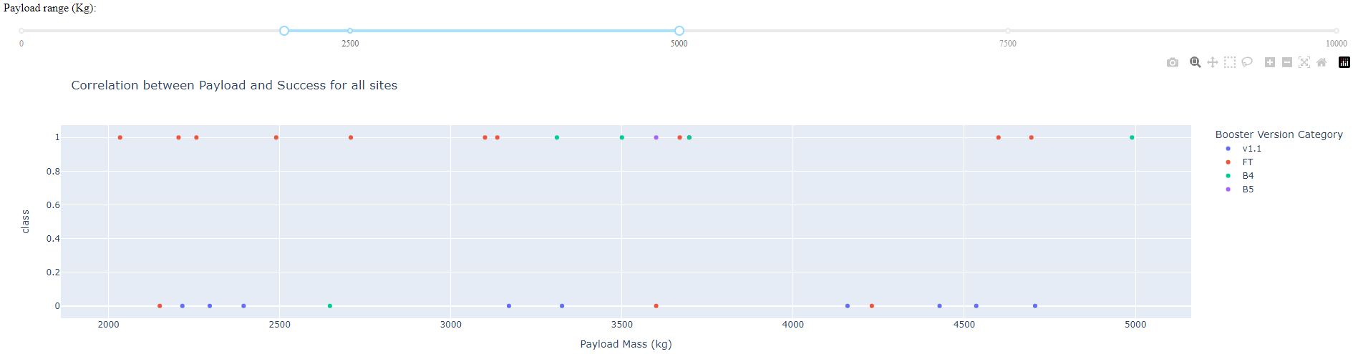
Payload vs. Launch Outcome
By zooming in on the range that was previously pointed, we see that inside this range, success seems to be more evenly distributed.
Below the 3200 Kg mark, all successful launches had a booster version of category FT

Slide 44

Section 5

Slide 45
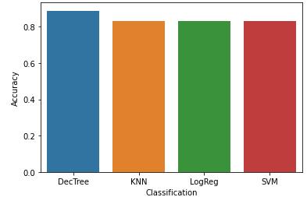
Classification Accuracy
Visualize the built model accuracy for all built classification models, in a bar chart
Find which model has the highest classification accuracy

Slide 46
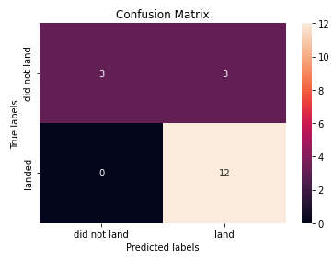
Confusion Matrix
The confusion matrix for the best model shows:
12 true positive results, where the model correctly predicted that the first stage would land
3 true negative results, where the model correctly predicted that the first stage would not land
0 false negative results, since the model did not falsely predict that a first stage would not land
3 false positive results, where the model falsely predicted that the first stage would land

Slide 47
Conclusions
The goal of the analysis was to assess the predictability of SpaceX Falcon 9 first stage landing, based on historic data.
The number of successful landings has been increasing throughout time, with the last years having a success rate of 0.8.
The location that stands out as the one with highest success rate is KSC LC-39A. However, this site only started being used after the 20th launch, which may bias the results
Different parameters, like payload mass, orbit type, etc. seem to have some relationship with success
Success can be predicted with a certain level of confidence using different classification models, although Decision Tree was the one with the best level of accuracy

Slide 48
Appendix
Complete project at:
https://github.com/ASPCalado/Capstone_project

Slide 49


